Slide 1
App Modernization – Migration approaches WW Developer Advocacy

Slide 2
Moving apps to modern architectures starts with planning

Slide 3
Assessment for each legacy app
Business value
Measure cost of migration vs benefits gained by migrating
Good value usually found in apps that have
Multiple upgrades per year
Lots of business rules requiring complex regression testing and extended service outages to implement
Large, stable (or growing) user base
Technical effort
This is where Transformer Advisor helps
Best candidates are those with relatively high business value and relatively small technical effort

Slide 4

The three ways to migrate…
Replatform
Repackage
Refactor
IBM Developer
Notes:
Key points to cover:
None of these three ways are the means for what you’ll do forever.
For example, after using Transformation Advisor, you may receive recommendations that alter your plans from a lift and shift to a refactor or rebuild.

Slide 5

Replatform example
Legacy app migrated in full from WebSphere Application Server Traditional to WebSphere Liberty running in a Kubernetes cluster
Transformation Advisor provides guidance with equivalent Liberty config for migrated app
Associated middleware is left in place and still used by migrated app
Before
After
Legacy app
Liberty Container
Migrated app
Middleware
Notes:
After explaining slide...
But we are getting a little ahead of ourselves. What are containers? How are they managed for productions applications? What does the stack for enterprise cloud native applications look like?
Let’s go through the underlying pieces starting with a bit more on containers.

Slide 6
Repackage to “macroservices”
Components (.war files) of legacy app (.ear) migrated to separate Liberty containers
DB2 is left in place and still used by migrated app
IBM MQ is partitioned
Container version handles communications between migrated modules
Legacy version handles communications between migrated modules and other legacy apps
Before
After
Legacy app (.ear)
war 1
war 2
Migrated apps
war 1
war 2
Middleware
Notes:
Repackaging into macroservices provides an improvement over Replatform – but we can do better when there is ROI by refactoring the application to microservies

Slide 7
Refactor using the Strangler Pattern
Component (war 3) of legacy app is rebuilt as a web app and a set of microservices
New microservices and app use their own containerized data and messaging middleware
Legacy app proxies all requests for war 3 to new implementation and handles everything else
Over time more of the legacy app is rebuilt and eventually it will be no longer be needed
Before
After
Legacy app (.ear)
Web app + microservices
war 1
war 2
war 3
Microservice 1
…
Microservice n
Web app
Middleware

Slide 8
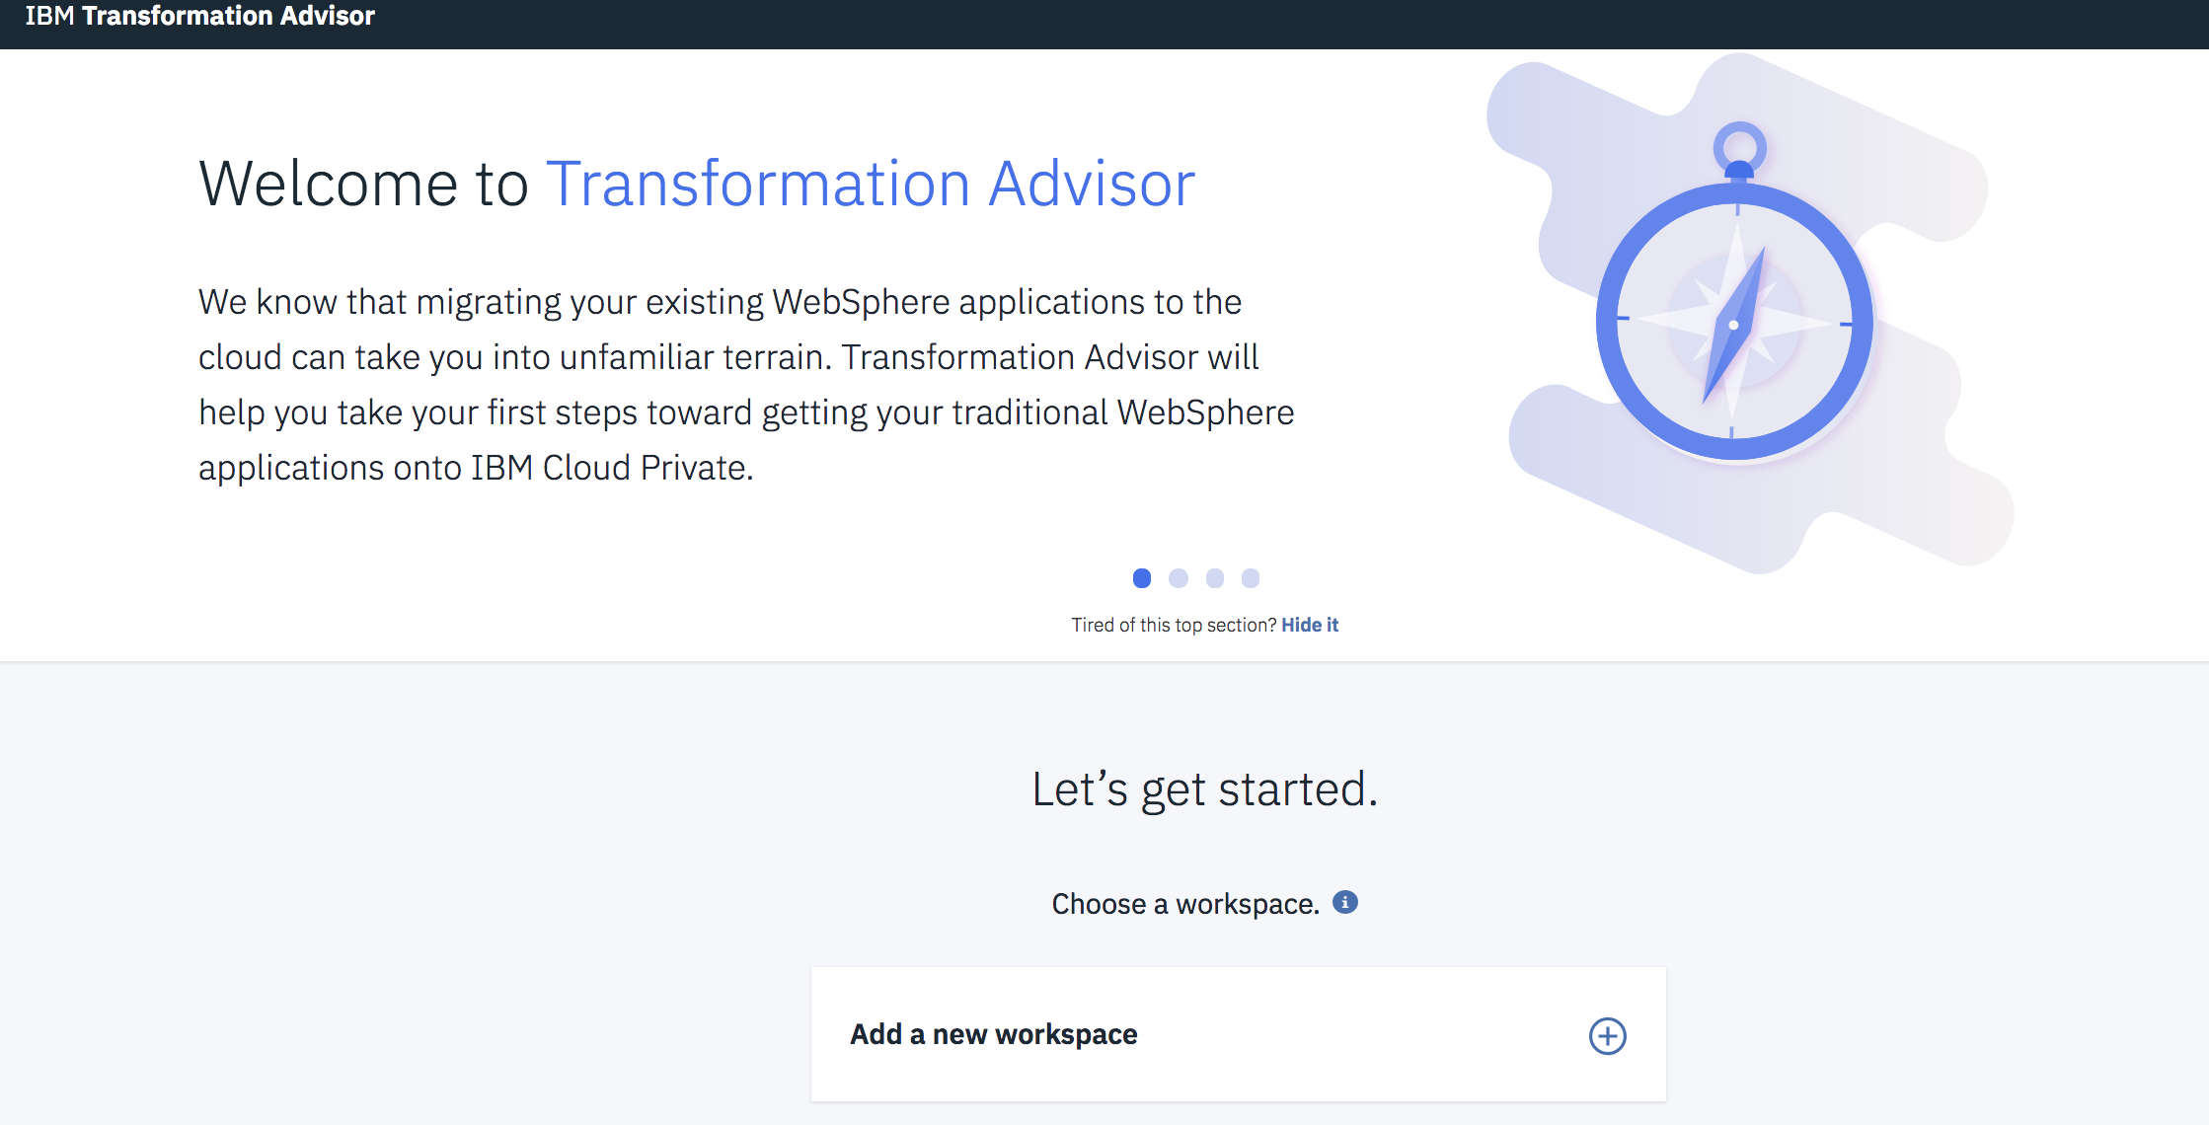
IBM Transformation Advisor
Collects information about your existing WebSphere/JBoss Environment and Applications, combines that with rules and insights gained from years of working with JavaEE applications, and provides recommendations for your cloud journey
CHALLENGES ADDRESSED
Leveraging existing application logic
Need to accelerate application development and maintenance
Monolithic applications that are complex and tightly coupled
BENEFITS
Included and deployed with IBM Cloud Pak for Applications
Introspects existing WebSphere/JBoss Deployments
Provides recommendations, guidance and artifacts for deployment in Liberty containers and Kubernetes clouds
https://developer.ibm.com/app-modernization/

Slide 9
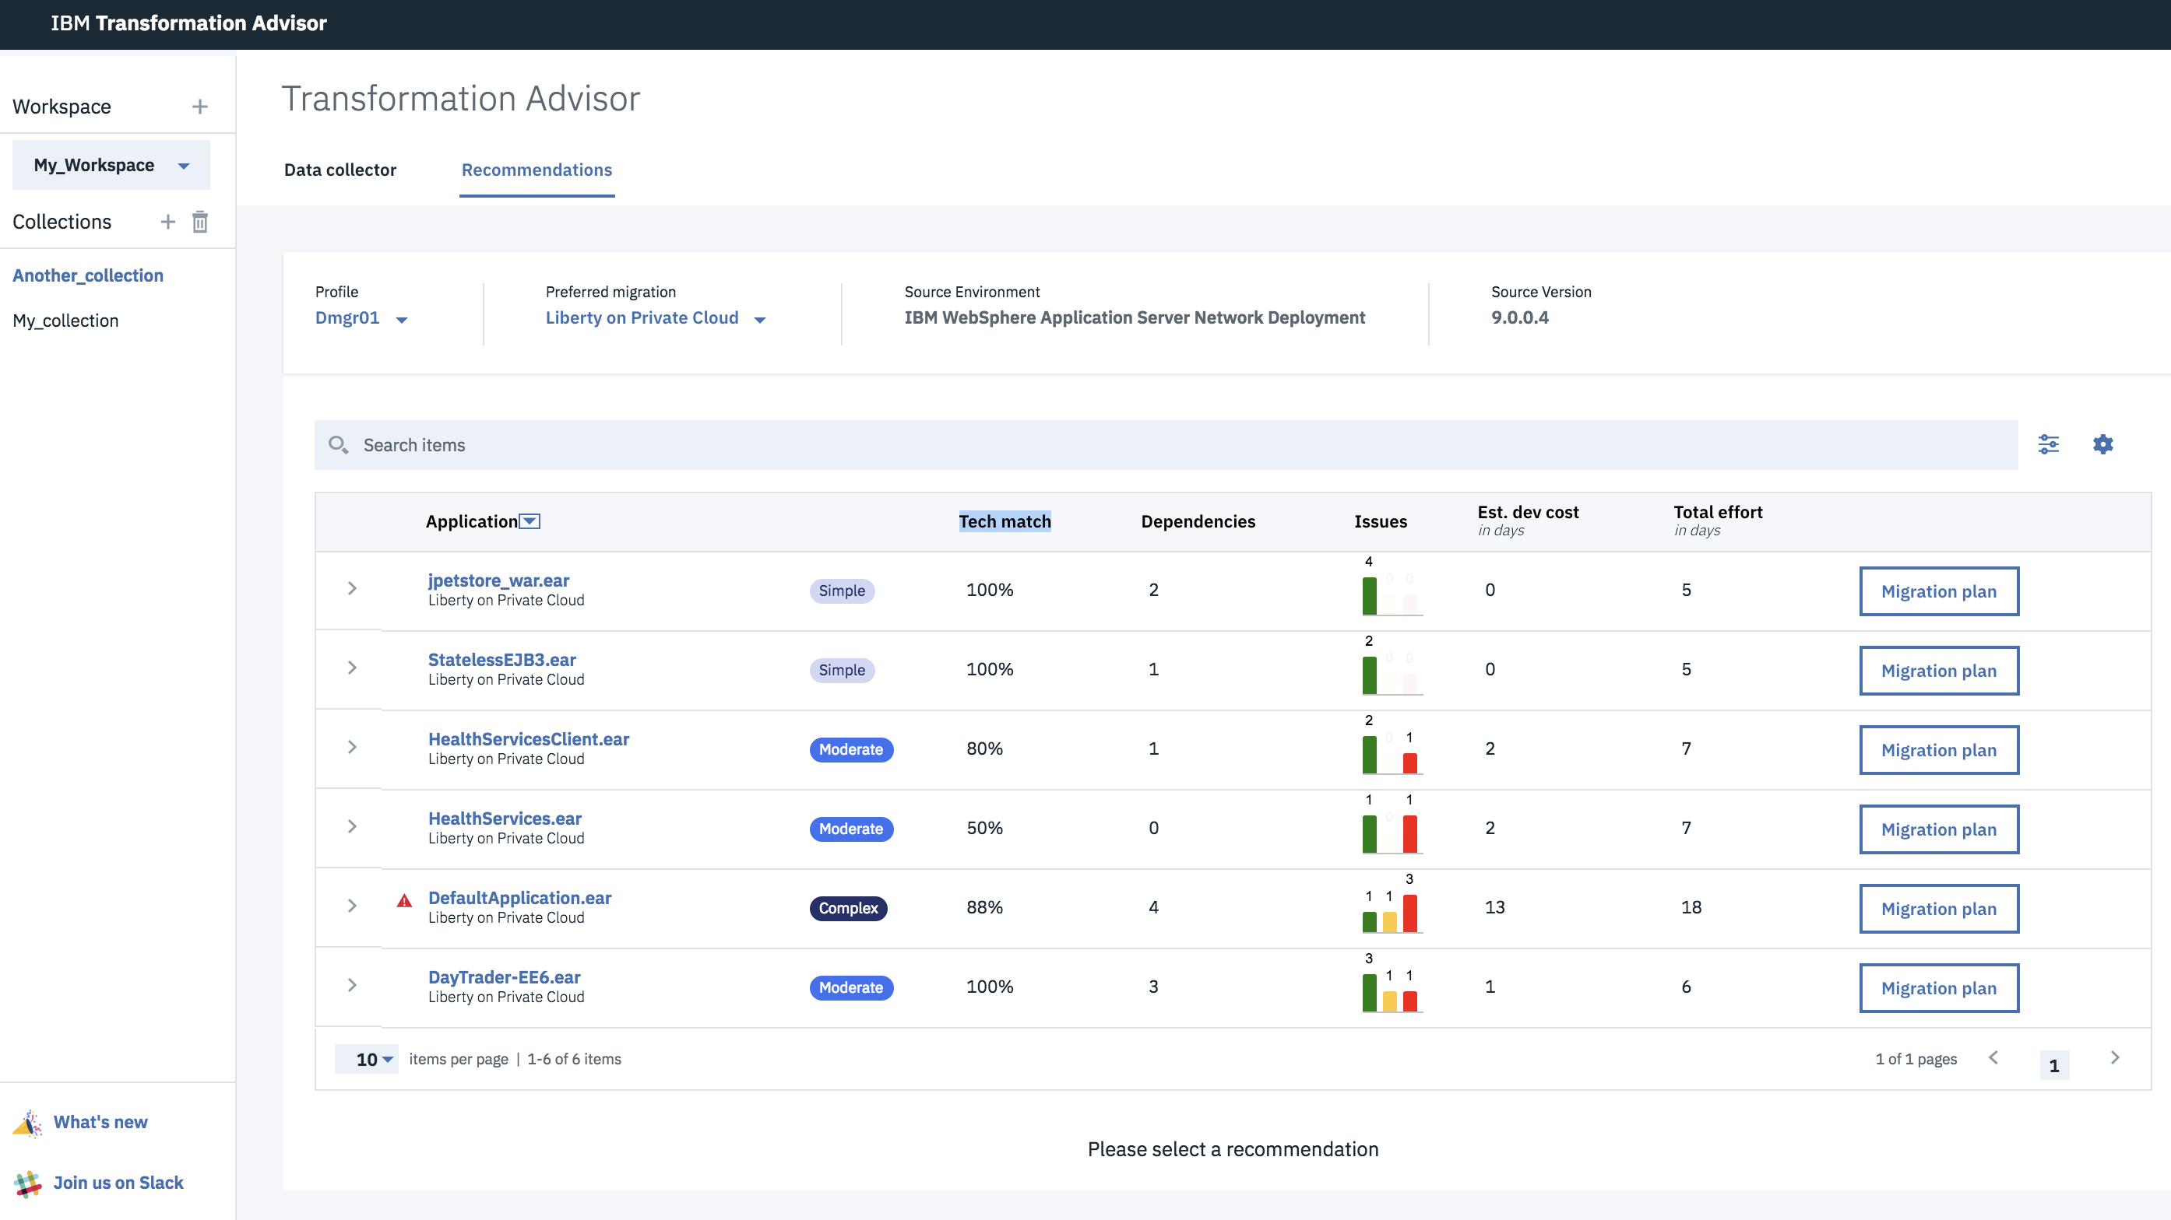
IBM Transformation Advisor
Creates application inventory, assesses modernization effort and provides insights and guidance …
Simple:
No code changes
Moderate:
Some refactoring needed
Complex:
May decide to run in WAS/JBoss in VMs before re-engineering

Slide 10
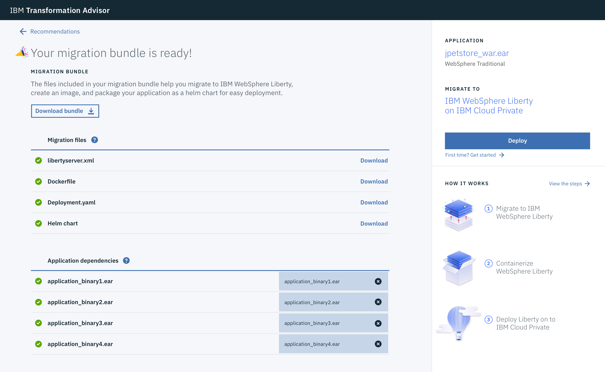
Transformation Adviser automates simple migrations
“Easy button” to enable simple migrations into IBM Cloud Private
Steps that occur behind the scenes to move the app over to Cloud Pak for Apps
IBM Cloud / © 2018 IBM Corporation

Slide 11
References
Newman, Sam. Building Microservices: Designing Fine-grained Systems. S.l.: O’Reilly Media, Inc, USA, 2018.
Chapter 5 – Splitting the Monolith specifically covers rebuilding a legacy app as a set of microservices
Evans, Eric. Domain-driven Design: Tackling Complexity in the Heart of Software. Boston, MA: Addison-Wesley, 2014.
Chapter 14 – Maintaining Model Integrity defines a bounded context. Identifying bounded contexts is the first step in splitting a monolithic application.
BoundedContext – Martin Fowler
https://martinfowler.com/bliki/BoundedContext.html
Feathers, Michael C. Working Effectively with Legacy Code. Upper Saddle River, N.J: Prentice Hall PTR, 2013.
Chapter 4 – The Seam Model defines a seam. Identifying seams with the appropriate level of granularity is an important step in defining microservice boundaries
Apply the Strangler Application pattern to microservices applications – Kyle Brown IBM Fellow
https://www.ibm.com/developerworks/cloud/library/cl-strangler-application-pattern-microservices-apps-trs/index.html?ca=drs-
Transformation Advisor
https://developer.ibm.com/recipes/tutorials/using-the-transformation-advisor-on-ibm-cloud-private/
Introduction to IBM’s app modernization approach
https://www.ibm.com/cloud/garage/content/culture/app-modernization-field-guide/

